Slide 1

BACKEND-I
By- Anish

Slide 2
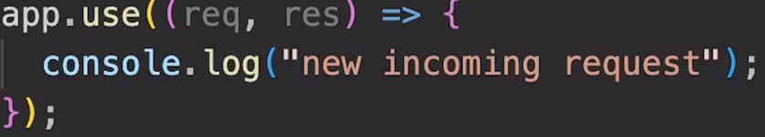
Handling request

Slide 3
SENDING A RESPONSE
Response :- Express 4.x - API Reference (expressjs.com)
Request

Slide 4
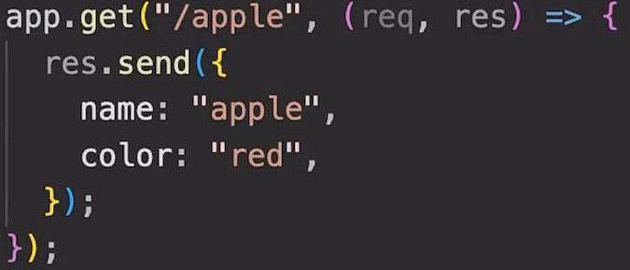
Routing
It is process of selecting a path for traffic in a network or between or across multiple networks.

Slide 5
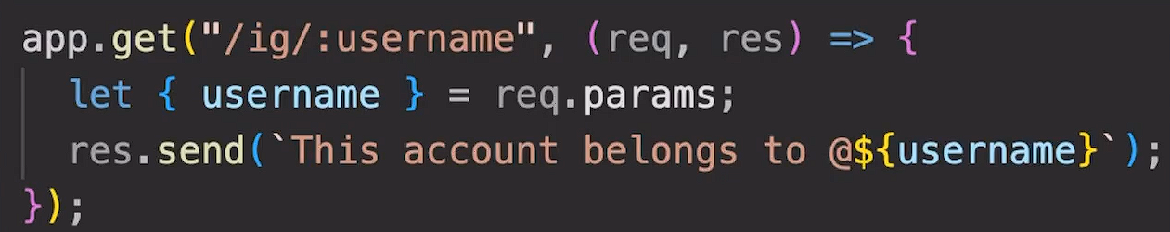
Path Parameters

Slide 6
Query String
?q=
?q=query&query

Slide 7
Templating
EJS(Embedded JavaScript templates).
EJS is a simple templating language that lets you generate HTML markup with plain JavaScript.
NPM i ejs

Slide 8
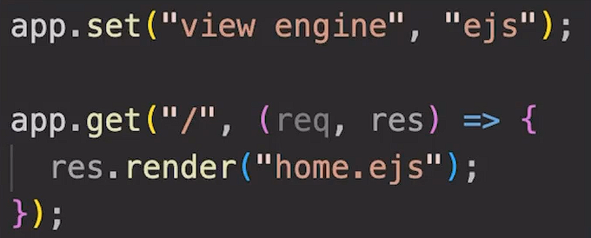
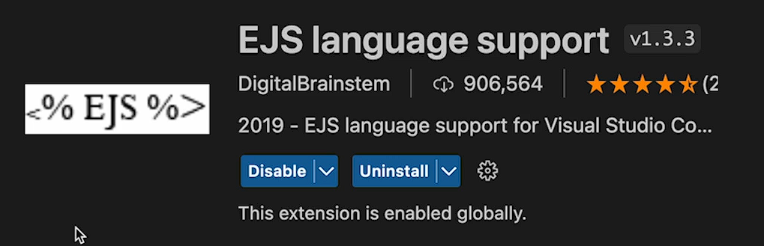
Using EJS

Slide 9
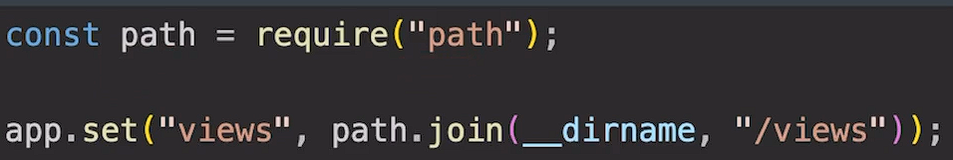
Views Directory

Slide 10
Interpolation Syntax
It refers to embedding expressions into marked up text.
EJS use kr k hum apne html ko dynamic bna skte h.
Website:- Ejs.co

Slide 11
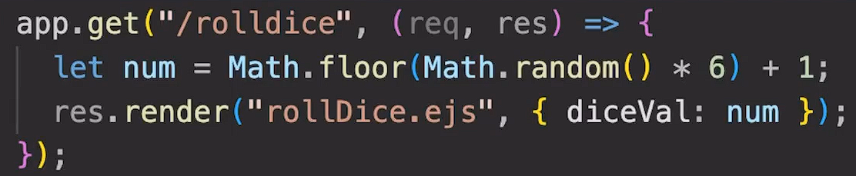
Passing data to EJS

Slide 12
Instagram EJS
Create a basic template for Instagram page based on following route:
/ig/:username

Slide 13
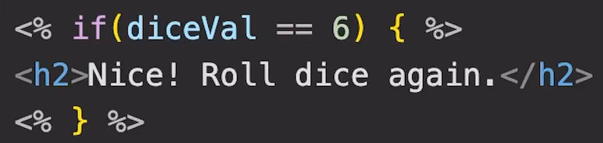
Conditional Statements in EJS

Slide 14
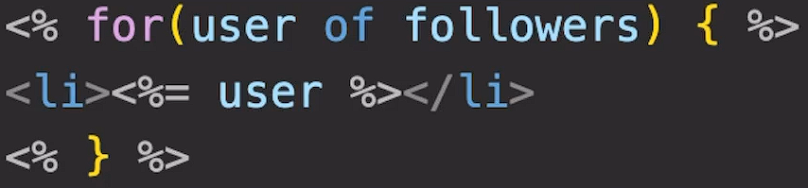
Loops in EJS

Slide 15
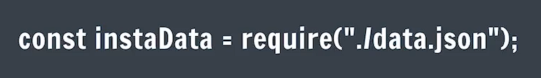
Instagram Page with EJS

Slide 16
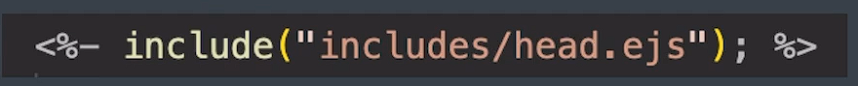
Includes
It is a way to create sub template.

Slide 17


Slide 18
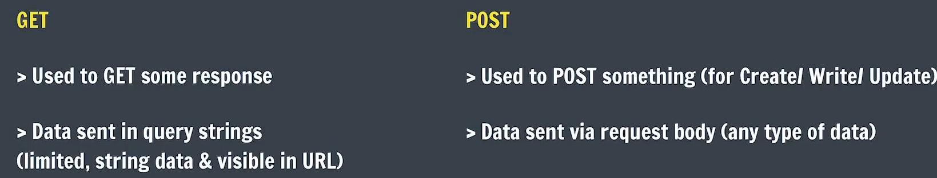
GET and POST Request

Slide 19
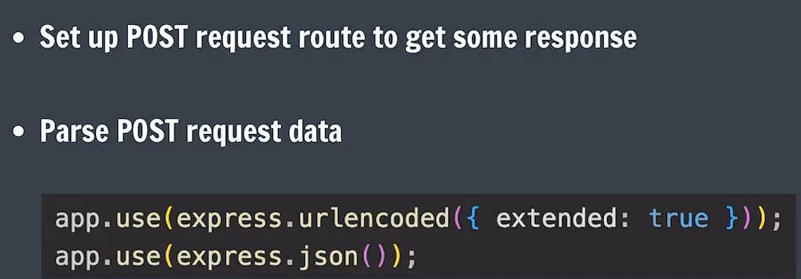
Handling POST Requests

Slide 20
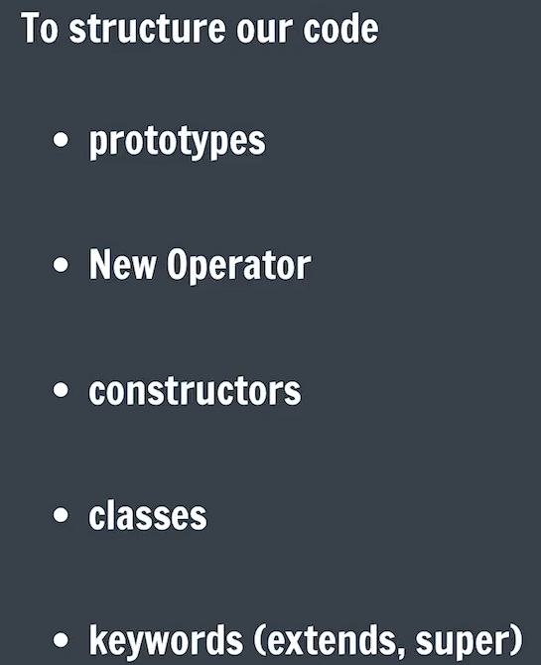
OOPS

Slide 21
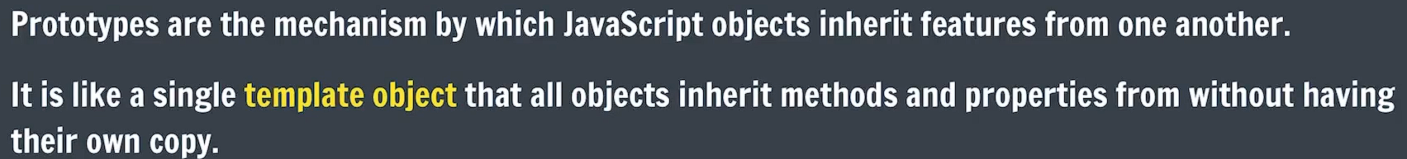
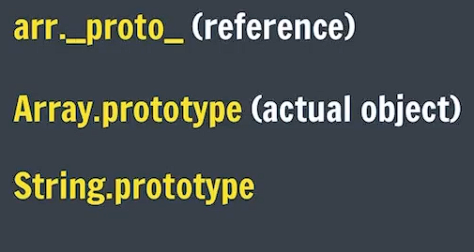
Object Prototypes

Slide 22
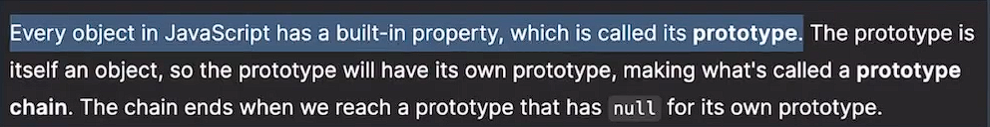
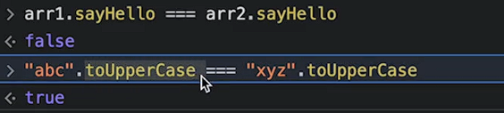
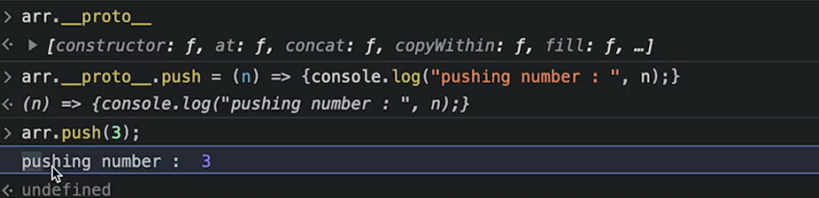

Slide 23
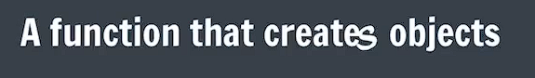
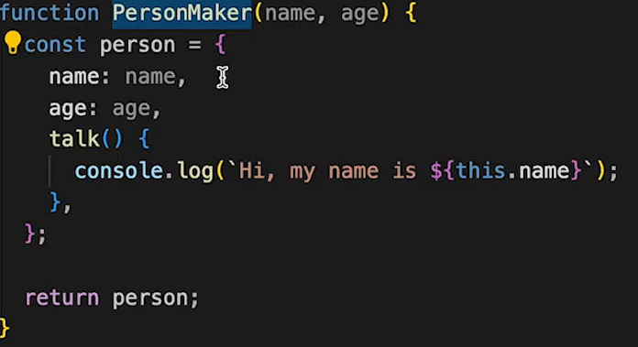
Factory Function

Slide 24
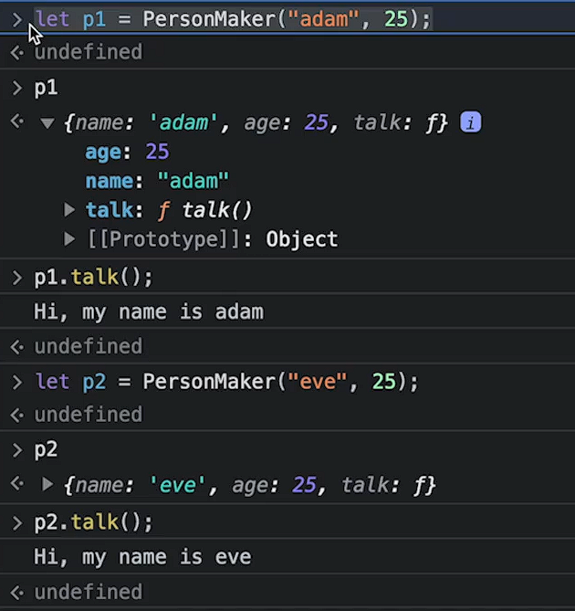

Slide 25
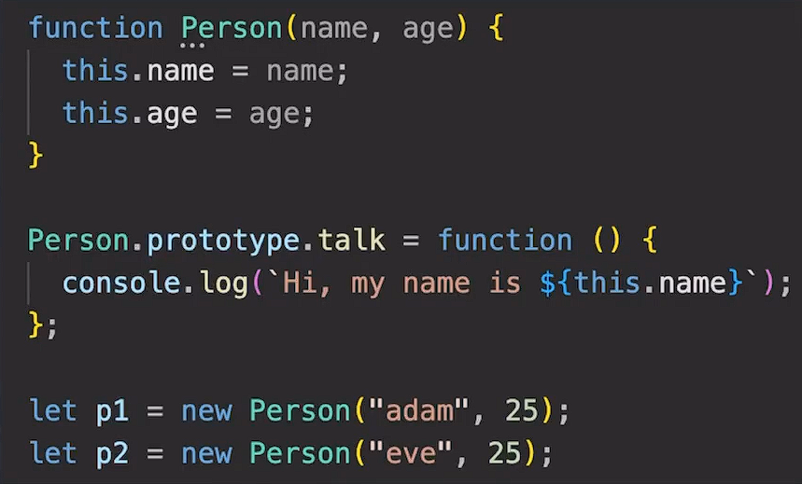
New Operator

Slide 26
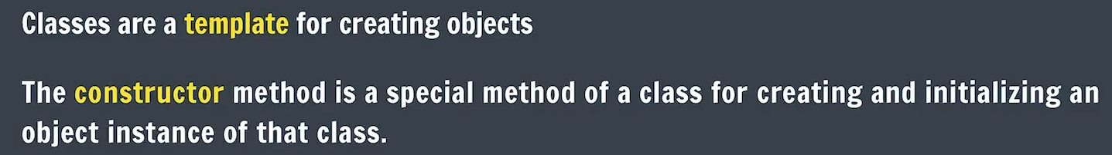
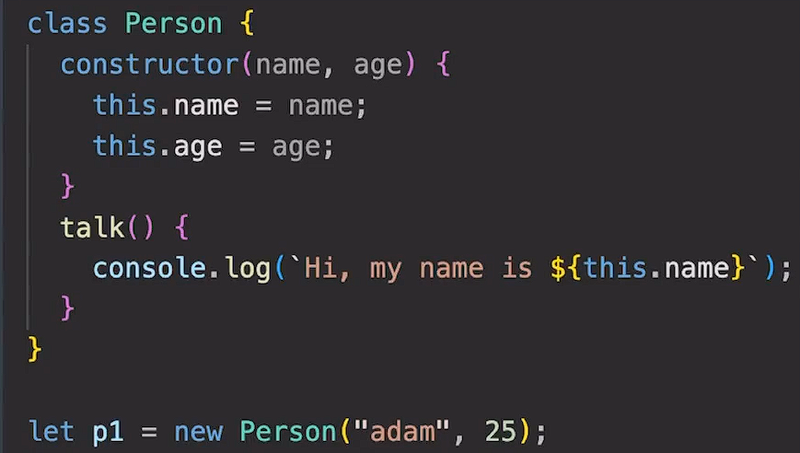
Classes

Slide 27
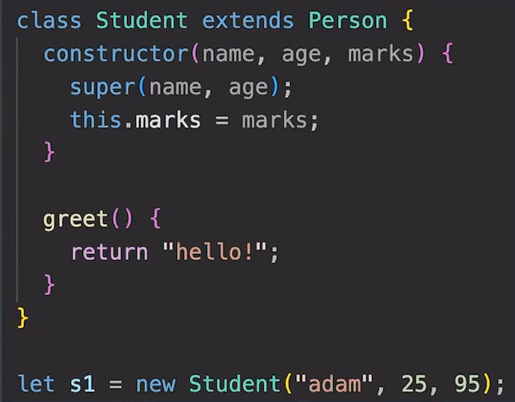
Inheritance

Slide 28
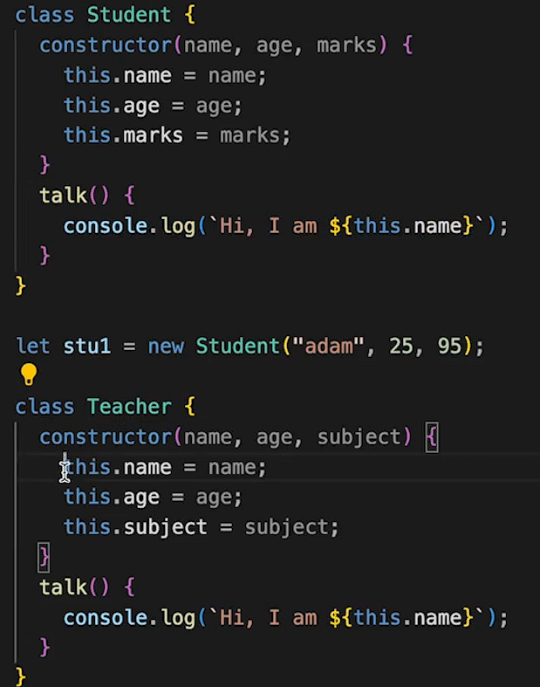
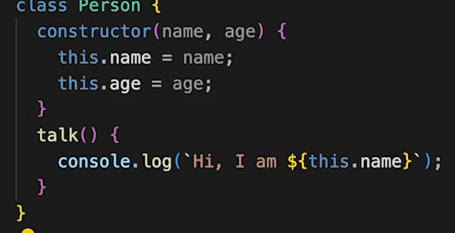
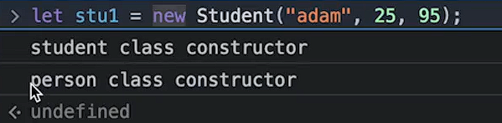

Slide 29
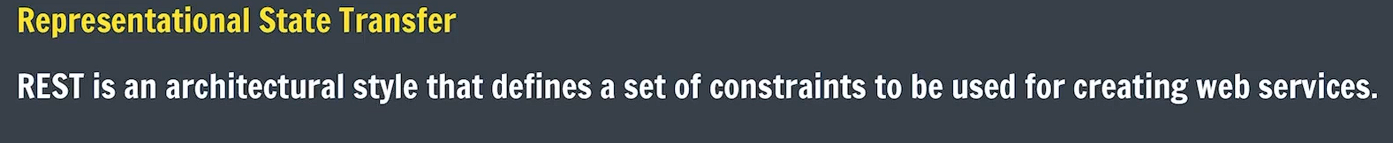
REST
developer.twitter.com/en/docs/api-reference-index
stackoverflow.blog/2020/03/02/best-practices-for-rest-api-design/

Slide 30
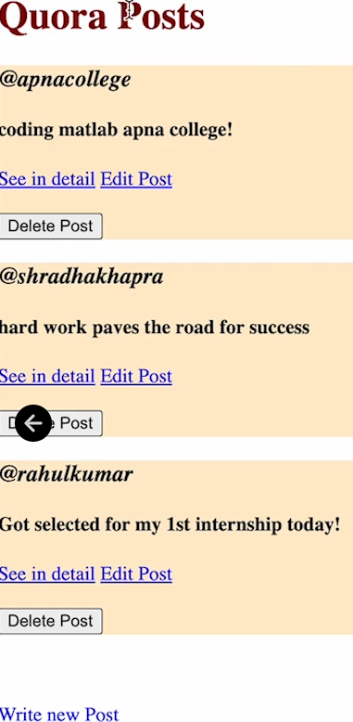
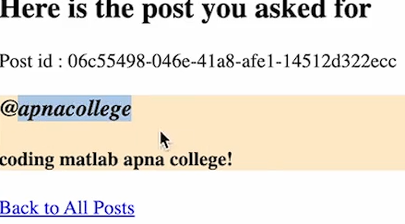
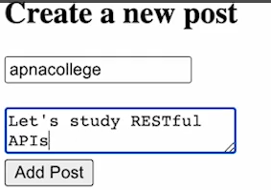
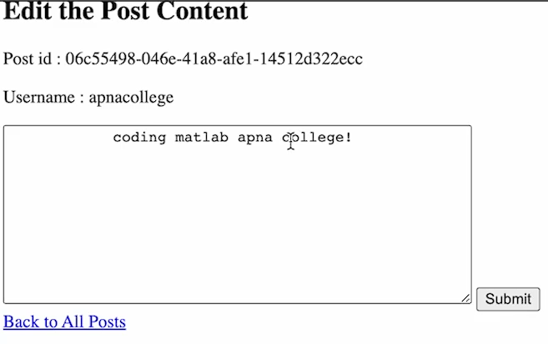

Slide 31
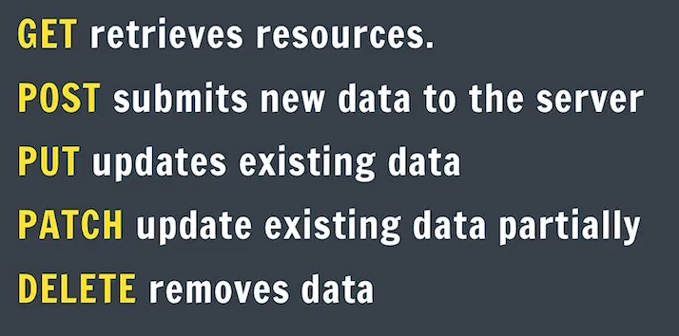
CRUD Operations

Slide 32
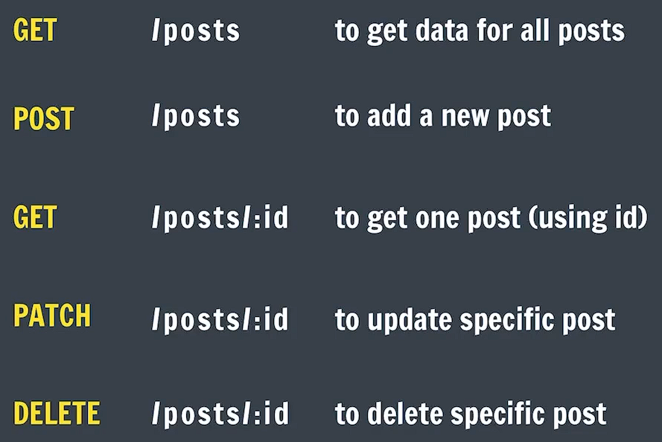
Creating RESTful APIs

Slide 33

Implement : GET/posts

Slide 34
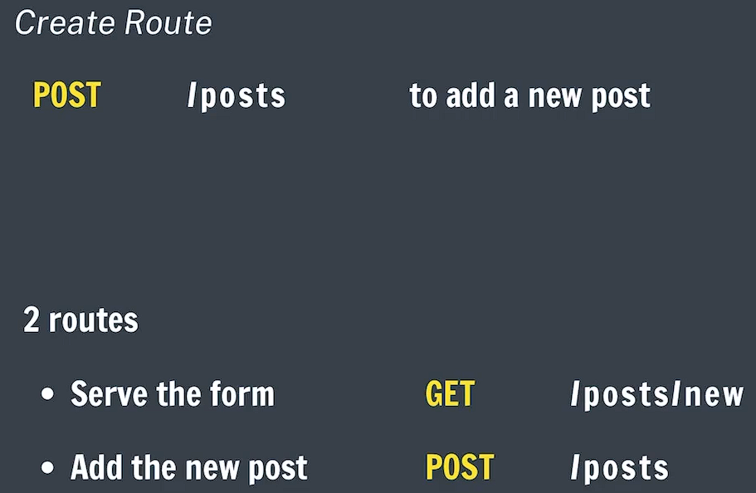
Implement : POST /posts

Slide 35
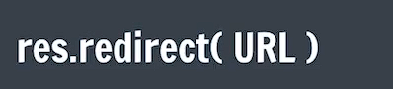
Redirect

Slide 36
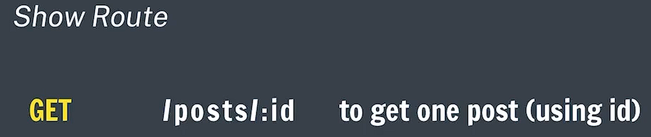
Implement : GET/posts/:id

Slide 37
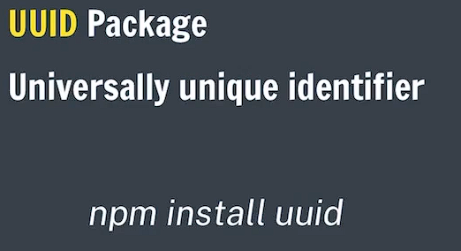
Create id for Posts

Slide 38

Implement: PATCH/posts/:id

Slide 39
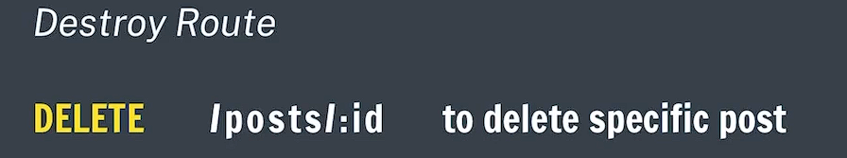
Implement: /posts/:id

Slide 40
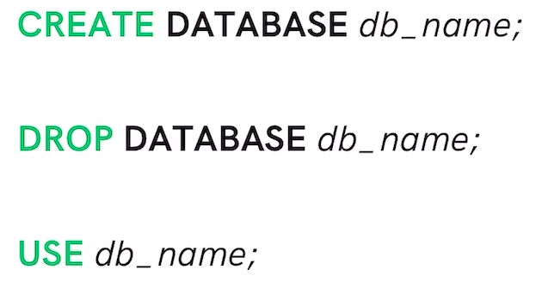
Our 1st Database

Slide 41
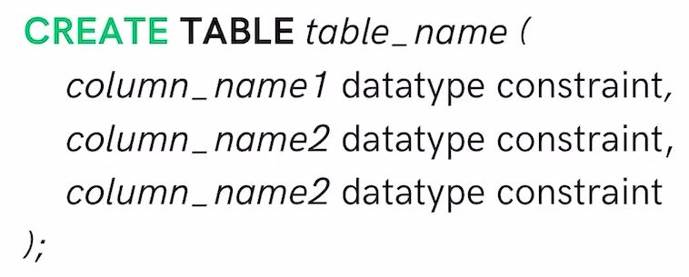
Our 1st Table

Slide 42
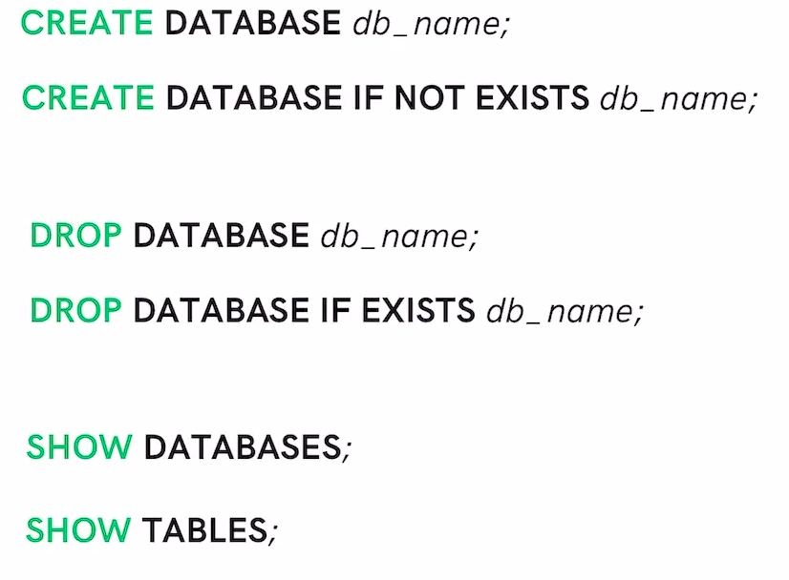
Database Queries

Slide 43
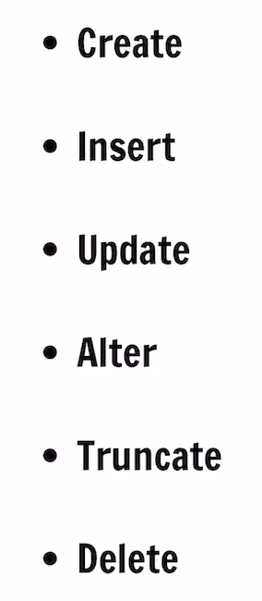
Table Queries

Slide 44
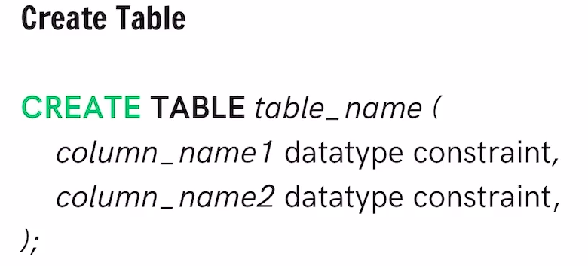
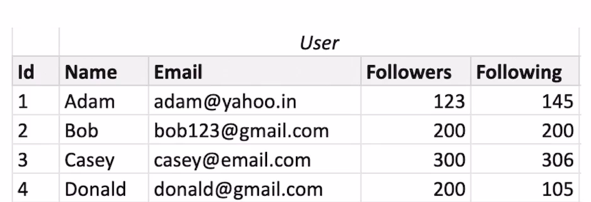

Slide 45
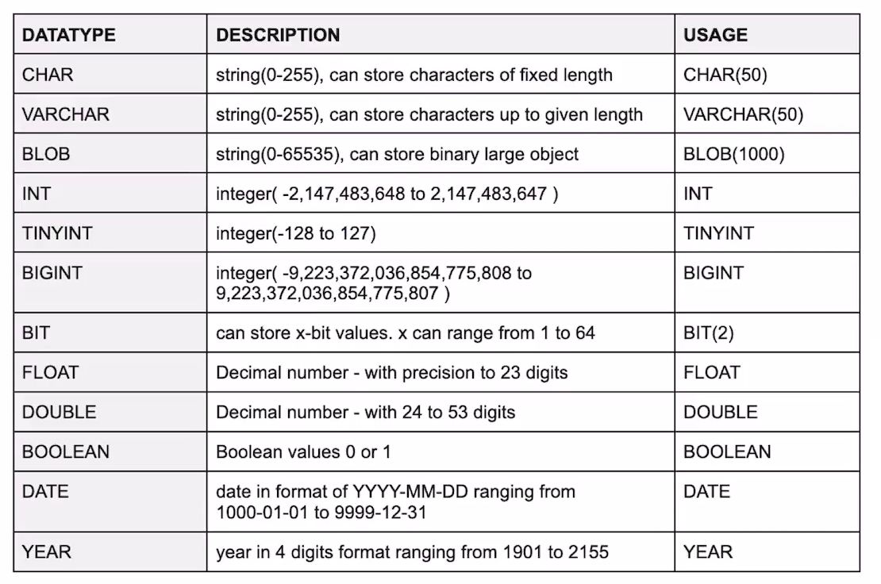
Data Types

Slide 46
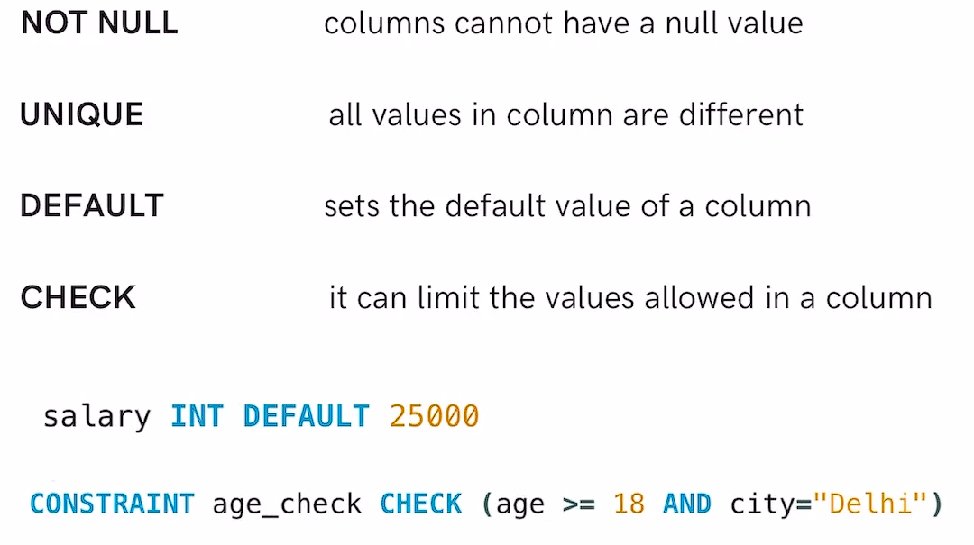
Constraints (Rules for data in table)

Slide 47
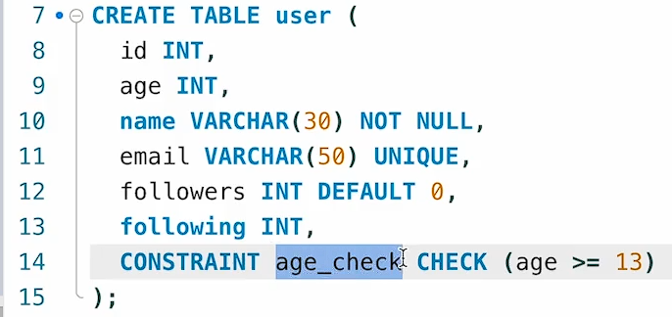

Slide 48


Slide 49



Slide 50



Keys

Slide 51

Table Queries

Slide 52


Slide 53

Select Command

Slide 54

Where Clause

Slide 55



Slide 56


Slide 57





Slide 58



Limit Clause

Slide 59


Order By Clause

Slide 60



Aggregate Functions

Slide 61

Group By Clause

Slide 62



Slide 63


Having Clause

Slide 64

General Order

Slide 65


Update

Slide 66

Delete

Slide 67

Alter

Slide 68



Slide 69





Slide 70

Truncate

Slide 71

Joins

Slide 72


Inner Join

Slide 73



Slide 74


Left Join

Slide 75



Slide 76


Right Join

Slide 77



Slide 78


Full Join

Slide 79


Slide 80

Self Join

Slide 81



Slide 83

Faker

Slide 84

MySQL2 Package

Slide 85

Using SQL from CLI

Slide 86

CREATE Table user

Slide 87

INSERT User

Slide 88

INSERT in Bulk

Slide 89
Routing
GET / → show no. of users in DB.
GET /user → show users(email, id, username)
PATCH /user/:id → username edit
POST /user → new user
DELETE /user/:id →user delete

Slide 90


Home Route // Add Template

Slide 91

Creating Our Routes

Slide 92

Creating Our Routes

Slide 93
Update Route
Search user based on id.
Check if form. Password = database password
Update username

Slide 94

Homework Task

Slide 95


Slide 96
Mongoose
A library that creates a connection between MongoDB & Node.js JavaScript Runtime Environment.
It is ODM (Object Data Modeling) Library.
NPM I mongoose
Mongoose v8.6.0: Schemas (mongoosejs.com)

Slide 97

Schema
Schema defines the shape of the documents within that collection.

Slide 98
Models
Model in mongoose is a class with which we construct documents.

Slide 99

Insert
Inserting One by One.

Slide 100

Insert (Multiple)

Slide 101
Note
Mongoose uses Operation Buffering.
Mongoose lets you start using your models immediately, without waiting for mongoose to establish a connection to MongoDB.

Slide 102

Find
Model.find() //returns a Query Object (thennable)
Mongoose Queries are not promises. But they have a .then()

Slide 103
Model.findOne() //returns a single result
Model.findById() //commonly used

Slide 104


Update
Model.updateOne()
Model.updateMany()

Slide 105

Find And Update
Model.findOneAndUpdate()
Model.findByIdAndUpdate()
//HW

Slide 106

Delete
Model.deleteOne() //return count
Model.deleteMany() //return count HW
Model.findByIdAndDelete() //HW
Model.findOneAndDelete() //HW

Slide 107

Schema Validations
Basically, Rules for Schema.

Slide 108

Schema Validation2
SchemaType Options

Slide 109

Schema Validation3 (Update)

Slide 110
MongoDB with Express

Slide 111

Basic Set up

Slide 112

Creating the Model (Chat)
Chat will have: (_id, from, to, message, created_at)

Slide 113

Initialize Database
Init.js

Slide 114

Chats
Index Route
GET /chats :- Show all chats

Slide 115

Chats
New & Create Route
GET /chats/new
POST /chats

Slide 116
Using Date

Slide 117

Chats
Edit & Update Route
GET ;- /chats/:id/edit
PUT :- /chats/:id

Slide 118

Chats
Destroy Route
DELETE :- /chats/:id

Slide 119
Project Phase 1

Slide 120

Basic Setup

Slide 121


Listing Models

Slide 122

Initialize Database

Slide 123


Slide 124


Index Route
GET /listings →all Listings (index.ejs)

Slide 125


Read : Show Route
GET /listings/:id →specific listing data view(Show.ejs)

Slide 126



Create: New & Create Route
GET /listings/new → Form →Submit
POST /listings

Slide 127


Slide 128


Update: Edit & Update Route
GET /listings/:id/edit → edit form open
POST /listings/:id →Submit
npm I method-override

Slide 129



Slide 130


Delete: Delete Route
Delete /listings/:id

Slide 131
Project Phase 2

Slide 132
Middle wares

Slide 133


Middle wares

Slide 134


Slide 135

What do middle wares do?

Slide 136

Our 1st Middle ware

Slide 137

Using next

Slide 138

Creating Utility Middleware
Logger means to print useful info on console like hostname, timing of incoming and outgoing requests. Eg:- Glassdoor

Slide 139
Exploring app.use() – app.use Callback
Documentation skew reading.

Slide 140


API Token as Query String

Slide 141

Multiple Middleware

Slide 142


Handling Errors

Slide 144

Error Handlers

Slide 145

Custom error class

Slide 146

Default Status & Messages

Slide 147
Error Class (Activity)

Slide 148

Handling Async Errors
Async function m koi error encounter hota h toh ush case m by default next ko call nhi lagata. Agar next ko call nhi lga toh means error handling proper nhi ho pai.

Slide 149


Using wrapAsync
Try catch likhna bulky ho jata h kbhi kbhi so we use another method to implement same.

Slide 150

Mongoose Errors

